Slide 1
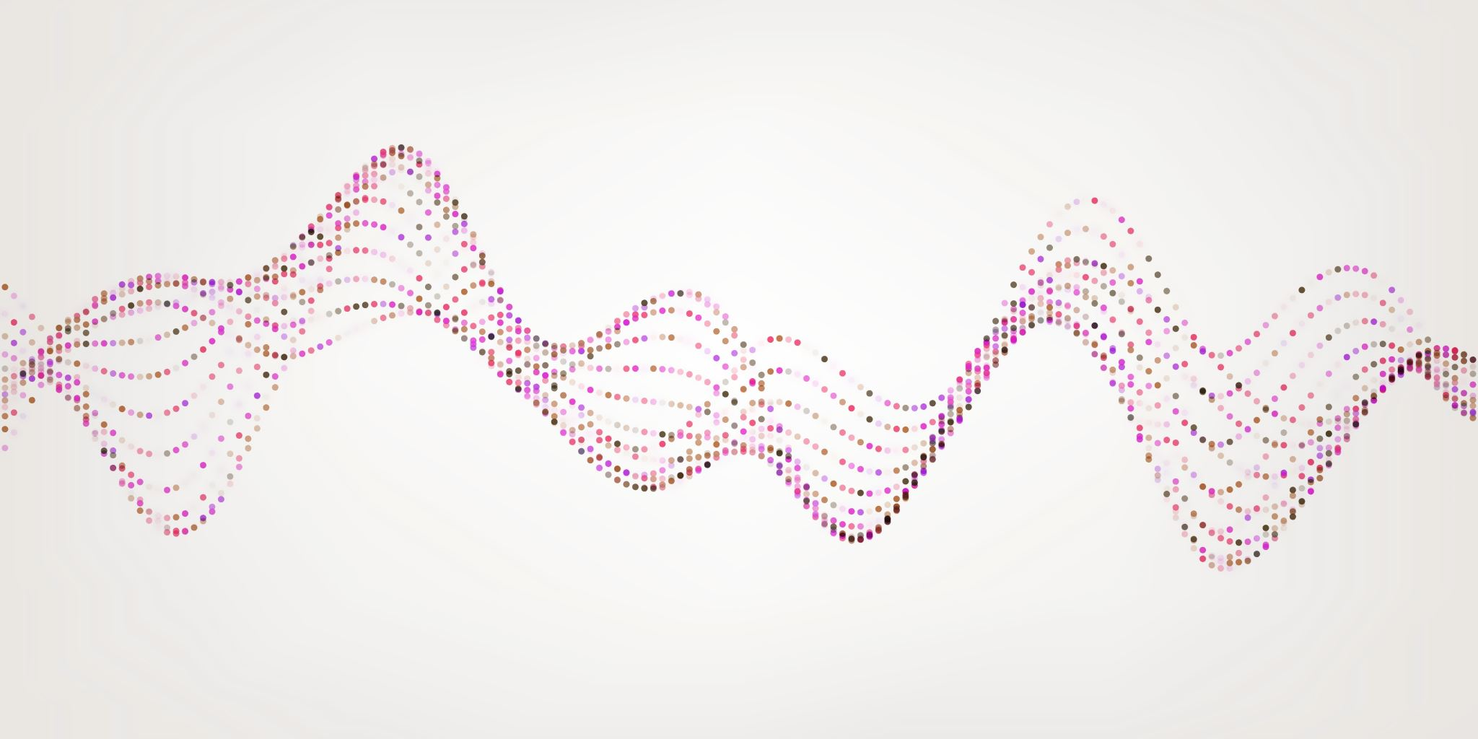
Detection of Covid-19 using deep Neural Networks with Chest X-Ray Images - Comparison of DarkNet and ResNet
CS 7313 Machine learning and pattern recognition
Advisor: Dr. Yan Yan
Team : Punitha Valli Devaraj and Aishwarya baskaran

Slide 2
INTRODUCTION
A newly identified coronavirus, SARS-CoV-2 has caused worldwide pandemic of respiratory illness called COVID-19
It can spread through droplets released into the air when an infected person coughs or sneezes.
RT-PCR: Time consuming, low sensitivity (60%-70%)
We propose a solution through the development of CNN for automatic diagnosis of COVID-19 amongst normal and pneumonia cases.

Slide 3
BACKGROUND
Due to insufficient test kits at early stage of pandemic – combining clinical image features with lab results helps early detection of Covid-19
Deep learning – successful in arrhythmia detection, breast cancer detection, pneumonia detection
Past research shows high accuracy in using CNNs to classify X-ray images for thorax diseases (L. Wang & Wong, 2020; X. Wang et al., 2017).
We aim to use dataset of normal, pneumonia, and COVID-19 chest X-rays and develop ML model using transfer learning
Figure 1. Chest X-ray images of a 50-year-old COVID-19 patient with pneumonia over a week.

Slide 4
DATASET EXPLORATION
In this study, dataset consisting of X-ray images obtained from two different sources were used for the diagnosis of COVID-19.
First, is from CohenJP(2020) COVID-19 Image data collection. Images from various open sources. Database is shared by different researchers.
https://github.com/ieee8023/covid-chestxray-dataset
This Repository is Ongoing data project collection. We had access to 115/127 total COVID-19 images, among which 43 are female and 72 are male cases that were found to be positive.
Second dataset for pneumonia and normal chest X-rays were gathered from the NIH Clinical Center (X. Wang et al., 2017)
We focused on pneumonia X-rays from the NIH dataset based on prior research that suggests that many COVID-19 patients develop pneumonia (CDC, 2020).

Slide 5
SAMPLE IMAGES FROM THE DATASET
Second dataset from NIH: 16756 images total. We randomly chose 1360 normal and 1360 pneumonia images.
Reference paper : DarkNet considered 500 normal and 500 pneumonia cases.
Our Final Dataset: 2835 X-rays images 224x224
Training and Testing Dataset are mutually exclusive.
Figure 2. A few COVID-19 cases and findings by dataset: (a) Cardio-vasal shadow within the limits, (b) Increasing left basilar opacity is visible, arousing concern about pneumonia, (c) Progressive infiltrate and consolidation, (d) Small consolidation in right upper lobe and ground-glass opacities in both lower lobes, (e) Infection demonstrates right airspace opacities, and (f) Progression of prominent bilateral perihilar infiltration and ill-defined patchy opacities at bilateral lungs.

Slide 6
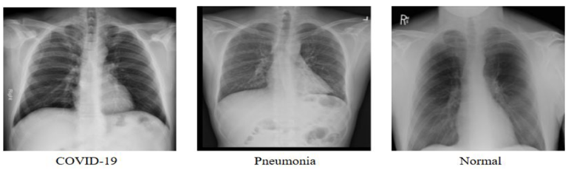
TRAIN: TEST SPLIT OF DATA
To ensure generalization, the training data was split into 60% training and 40% validation sets.
a 60-40 split showed the best generalization performance in test accuracy.
Figure 3. Images from the final dataset into 3 classes – Covid-19, Pneumonia, Normal.
Train – Test Split of data | Training Accuracy(%) | Testing Accuracy(%)
80% - 20% | 95.01 | 86.55
60% - 40% | 95.08 | 91.95
50% - 50% | 96.51 | 85.43

Slide 7
CHOOSING THE MODEL
In this study, major challenge is lack of Covid-19 X-rays.
4.4% of training and 0.47% of test dataset.
Every patient’s body can react differently to infections, which may be apparent in chest infection localization.

Slide 8
A. TRANSFER LEARNING
Rational approach – use of pre-trained models.
Trained on large benchmark dataset to solve the problem similar to the one we want to solve
Can be summarized as
Select the pre-trained model
Classify the problem according to size-similarity matrix
Fine-tune the model according to our requirements.

Slide 9
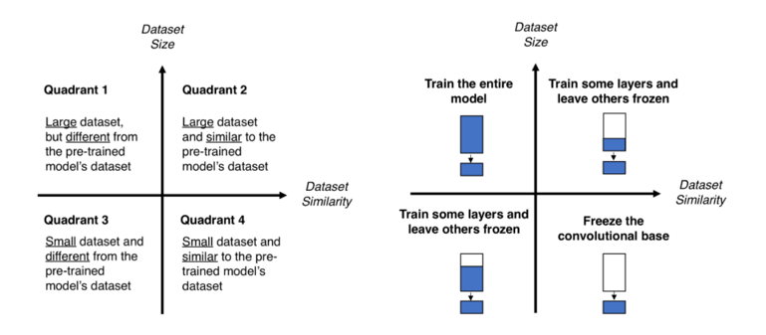
SIZE-SIMILARITY MATRIX
We have selected Quadrant 1 since ours is large dataset(>1000 images) and different from pre-trained models' dataset (cats and dogs).
Figure 5. Size-Similarity matrix (left) and decision map for fine-tuning pre-trained models (right).

Slide 10
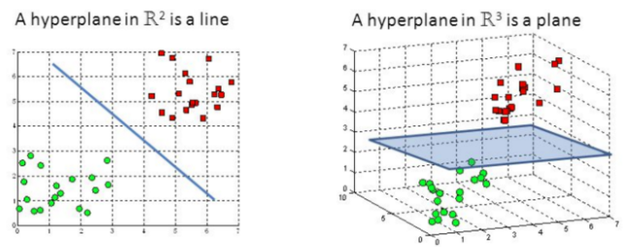
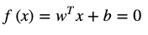
B. SVM CLASSIFIER
Support Vector Machine – significant accuracy and less computational power
Algorithm : find a hyperplane in an N-dimentional space that distinctly classifies the data points.
Supper vectors are data points closer to hyperplane. Maximize the margin of the classifier
Proposed model: SVM with linear kernel , epsilon value is set as 0.04
The linear separation of the positive and negative samples can be handled using below equation
w is weight vector , b is bias value
Figure 6. Hyperplanes in 2D and 3D feature space.

Slide 11
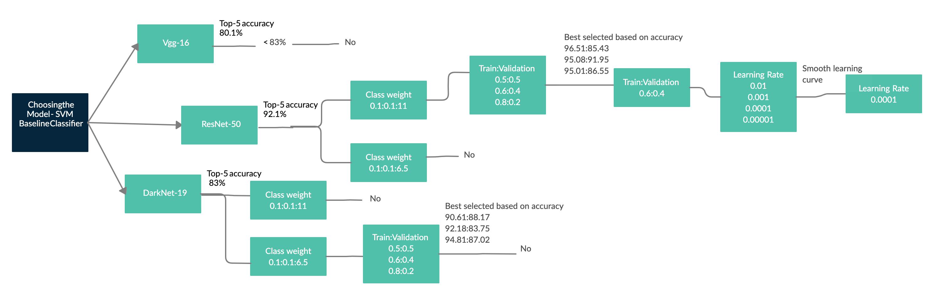
C. SELECTING THE PRE-TRAINED MODEL RESNET50
Decision Tree – predictive modelling approach
Non-parametric supervised learning method used in both classification and regression tasks

Slide 12
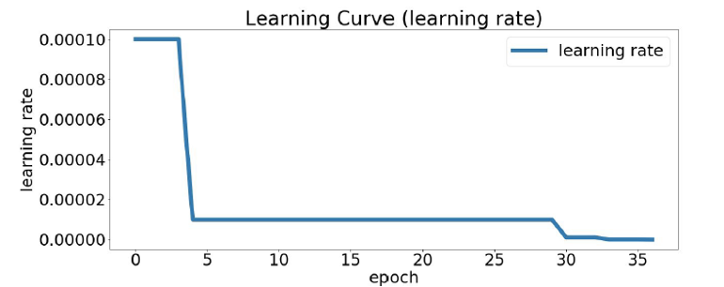
SMOOTH LEARNING CURVE
Learning rate at 0.0001 produced smooth learning curve than higher learning rate which enables faster convergence than lower learning rate
Avoid being trapped into local minimums too early

Slide 13
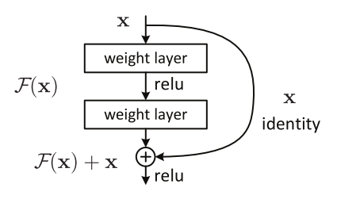
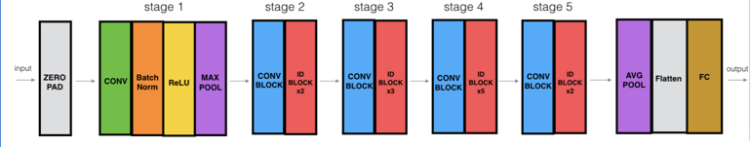
Pre-trained ResNet Architecture
Core Idea – Residual Network so called ‘ identity shortcut connections’ that skips one or more layers
Stacks convolutional layers but also adds original input to the output of convolutional layer
ResNet 50 Model – 5 stages , each convolutional block has 3 convolutional layers, and each identity block has 3 convolutional layers.
23 million trainable parameters.

Slide 14
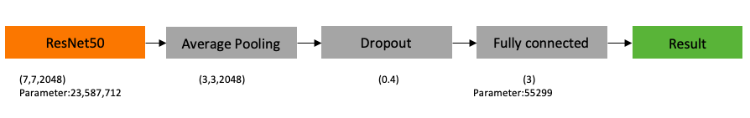
PROPOSED RESNET-50 ARCHITECTURE
Pre-trained ImageNet weights, tuned hyper parameters, added layers
Average pooling between ResNet50 output and FC
Reference paper: Max Pooling – loss in variation of image mainly for Pneumonia and Covid-19 patients.
Dropout layer – to avoid overfitting.
Data augmentation – rotate, flip, cropping, shearing

Slide 15
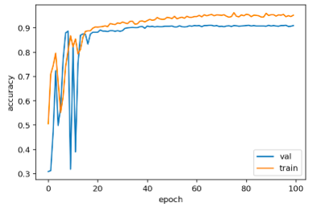
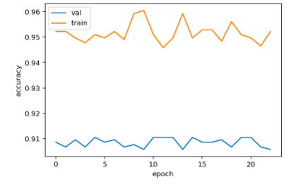
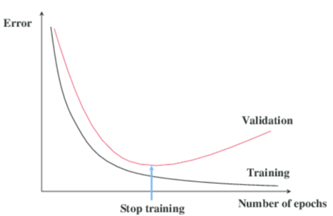
Early Stopping feature
Used to combat the overfitting issue.
Stop training as soon as the validation error reaches minimum
In our project, we are monitoring validation loss at patience=10, mode=min.
Adam optimizer , 0.0001 learning rate , categorical cross entropy loss function
Validation and training accuracy

Slide 16
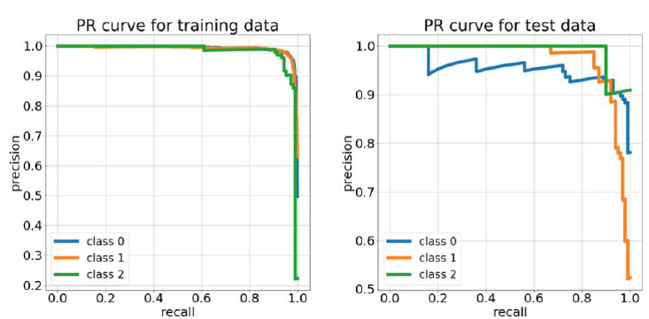
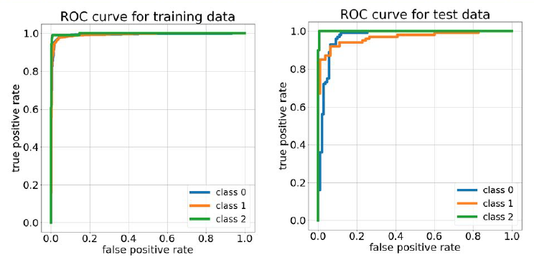
EXPERIMENTAL RESULTS – PR and ROC curve
Train accuracy – 95.08% Test accuracy – 91.95%
Findings/Accuracy | Train |  | Test
 | Precision | Recall | Precision | Recall
Normal | 0.95 | 0.96 | 0.94 | 0.89
Pneumonia | 0.94 | 0.95 | 0.90 | 0.92
Covid-19 | 0.96 | 0.95 | 0.83 | 0.88
Accuracy | 95.08 |  | 91.95

Slide 17
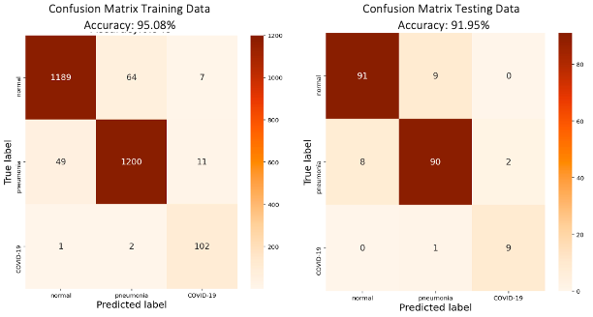
CONFUSION MATRIX – TRAINING AND TESTING DATA OF RESNET

Slide 18
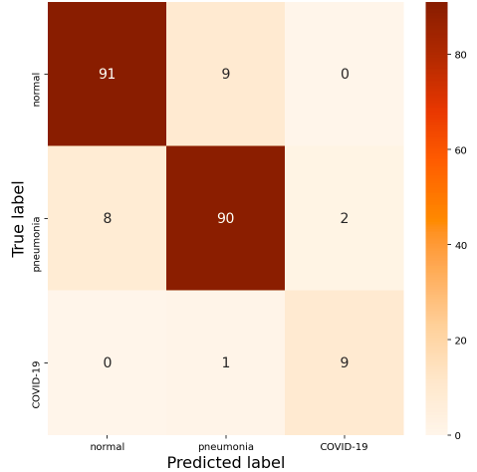
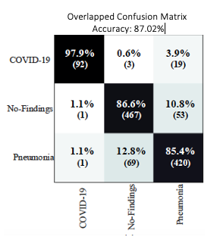
CONFUSION MATRIX – COMPARISON OF OUR RESTNET WITH DARKCOVIDNET

Slide 19
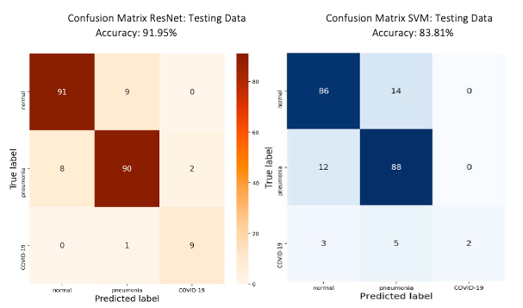
CONFUSION MATRIX – RESNET WITH SVM

Slide 20
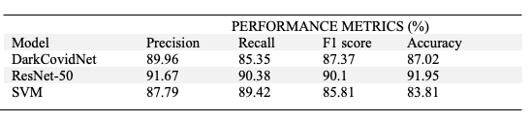
CLASSIFICATION REPORT

Slide 21
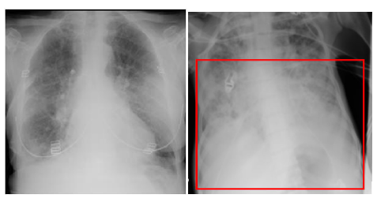
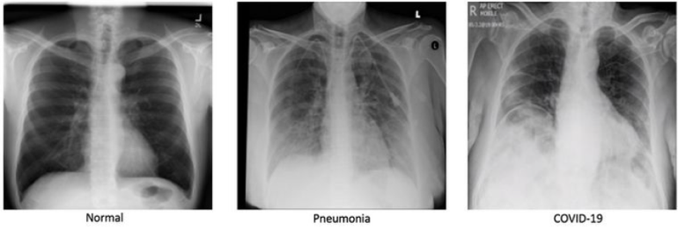
PROPOSED MODEL – BATTLE AND DEFEAT
Battle:
Figure 19a - Predicted pneumonia but actually COVID-19
Figure 19b - Predicted COVID-19 but actually pneumonia
Defeat: Properly classified

Slide 22
CONCLUSION
We present a deep learning model to distinguish amongst normal, pneumonia, and COVID-19 X-rays, with the goal of diagnosing COVID-19 in the current pandemic.
This system can be used in remote places in countries affected by COVID-19 to overcome a shortage of radiologists. Also, such models can be used to diagnose other chest-related diseases including tuberculosis and pneumonia
A limitation of the study is the use of a limited number of COVID-19 X-ray images. We intend to make our model more robust and accurate by using more such images from our local hospitals.
Future work should seek advice from a radiologist to better understand these X-rays to improve model performance

Slide 23
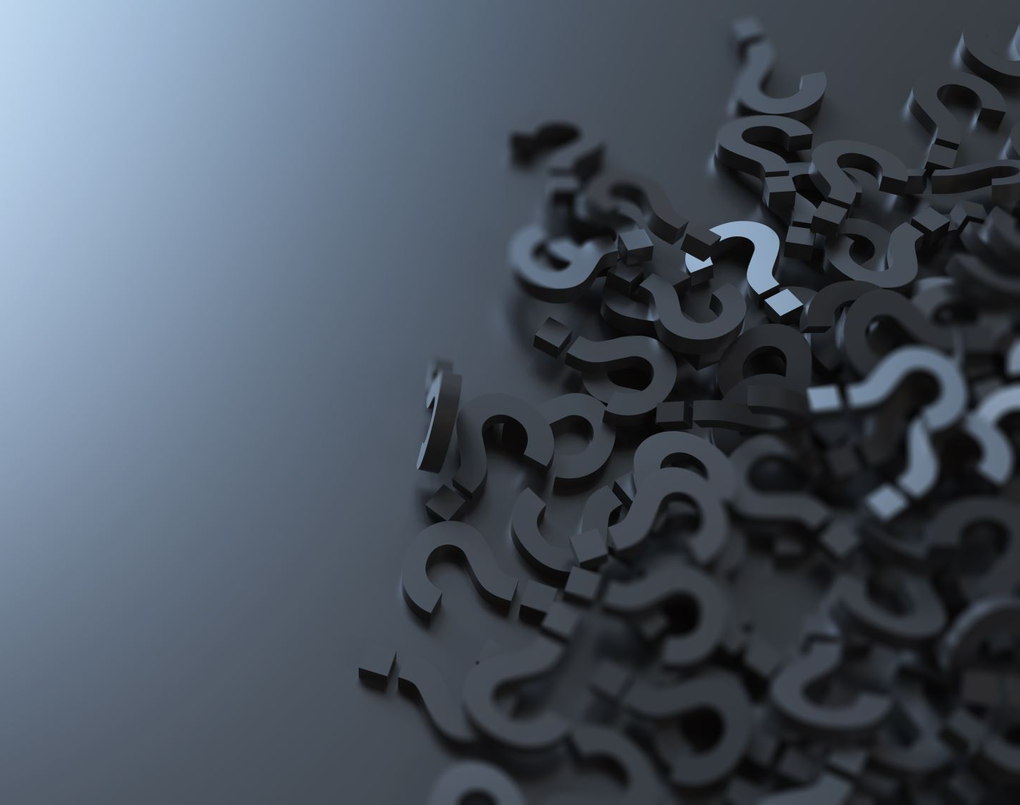
QUESTIONS?

